Slide 1
AI and Society Talk 11/19
Owen Lockwood

Slide 2
Overview
Reinforcement Learning (RL)
Quantum Computing
Quantum Machine Learning (QML)
Quantum RL
What can you do?

Slide 3
What is Reinforcement Learning?
Machine Learning
Supervised Learning:
Learn a function approximator based on labeled training data
{(x_{n}, y_{n})}
Unsupervised Learning:
Pattern and feature analysis on unlabeled data
{(x_{n})}
Reinforcement Learning
Learning to maximize a reward signal by interacting with an environment
{(x_{n}, r_{n})}

Slide 4
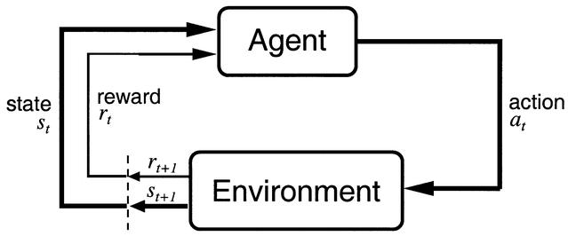
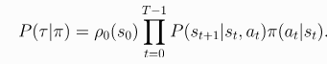
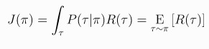
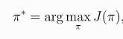
What really is RL?
[1]
Technical Blurb:
RL is an optimization problem:

Slide 5
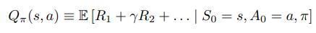
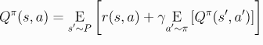
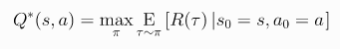
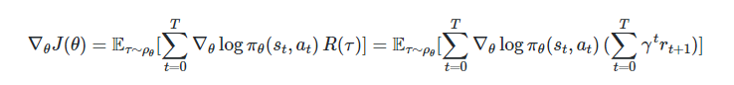
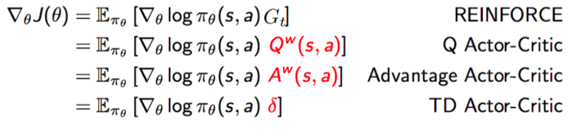
How do you do RL?
Model Based:
Given the model
Learn the model
Model Free:
Value Methods
Policy Methods
Actor-Critic Methods

Slide 6
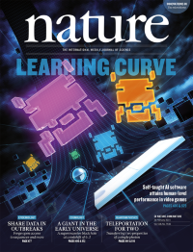
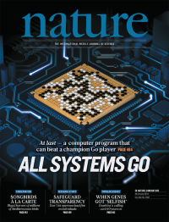
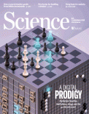
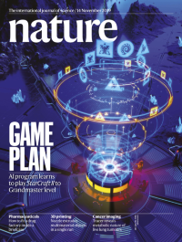
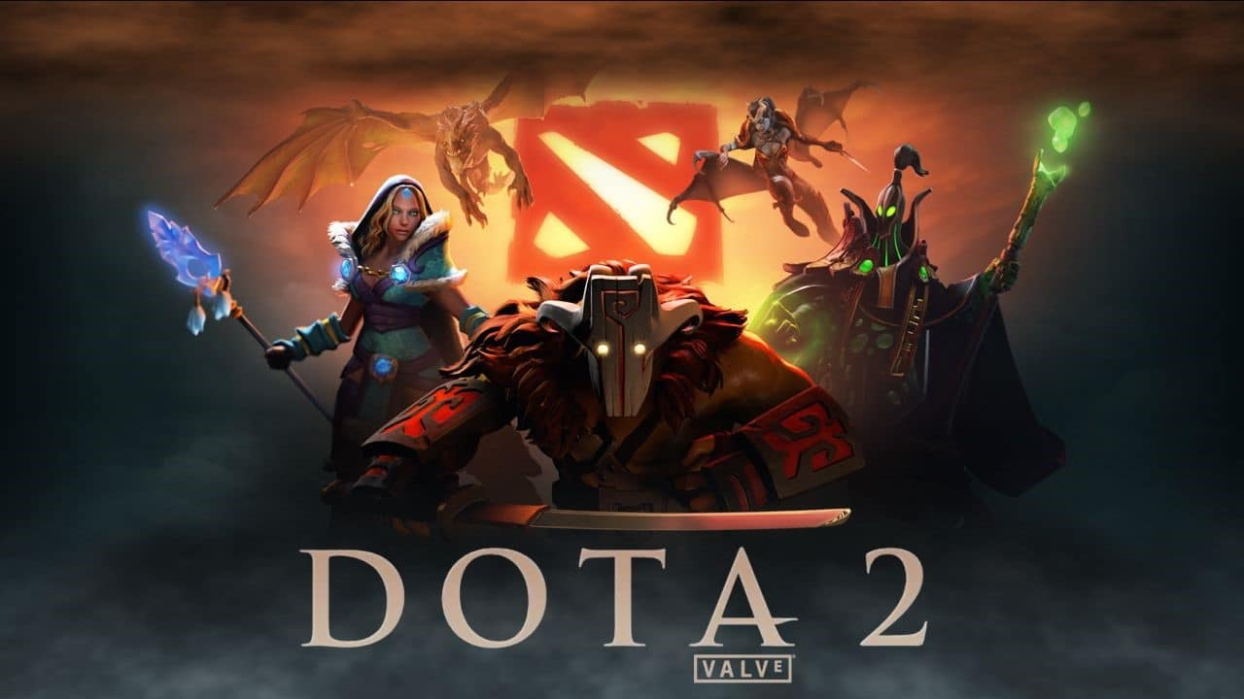
What can RL do?
[8]
[2], [3]
[4]
[5]
[6], [7]

Slide 7
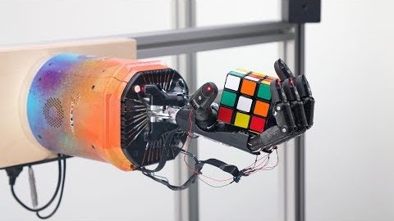
[9]

Slide 8
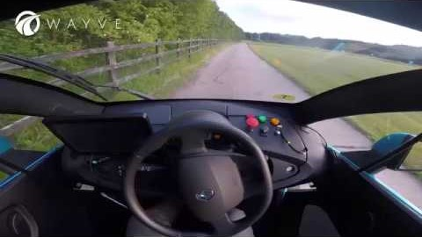
[10]

Slide 9
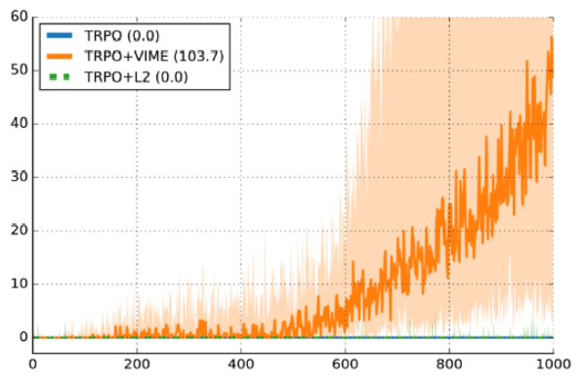

Problems with RL
“Whenever someone asks me if reinforcement learning can solve their problem, I tell them it can’t. I think this is right at least 70% of the time.” –Alex Irpan
Brittle, so, so brittle:
[11], [12], [13]
Inefficient:
Millions of frames (dozens of hours) to play Atari
> $10,000,000 of TPU time to train AlphaStar
In 2018, AlphaGo Zero >$30,000,000 of TPU time
Environmental Impact: [14], [15]
Notes:
There are better methods: see TCEC and random search

Slide 10
Real World RL
Currently very few real-world use cases
Lots of challenges: [16], [17]
Growing field:
2020 Virtual Conference on Reinforcement Learning for Real Life
NeurIPS 2020 Workshop: Challenges of Real-World RL
Lots of important social implications

Slide 11
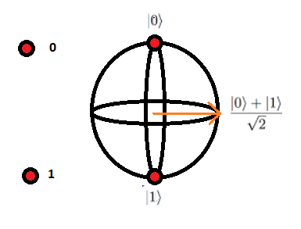
What is Quantum Computing?
Classical Bits vs Quantum Bits: [18]

Slide 12
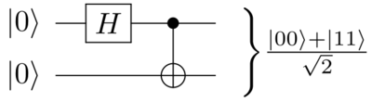
Why Quantum Computing?
Superposition:
wavefunction is a linear combinations,
Information for N classical bits is N bits, for N qubits is 2^N bits
Entanglement: state of each qubit cannot be described independently of the state of the others, e.g. EPR state [19]

Slide 13
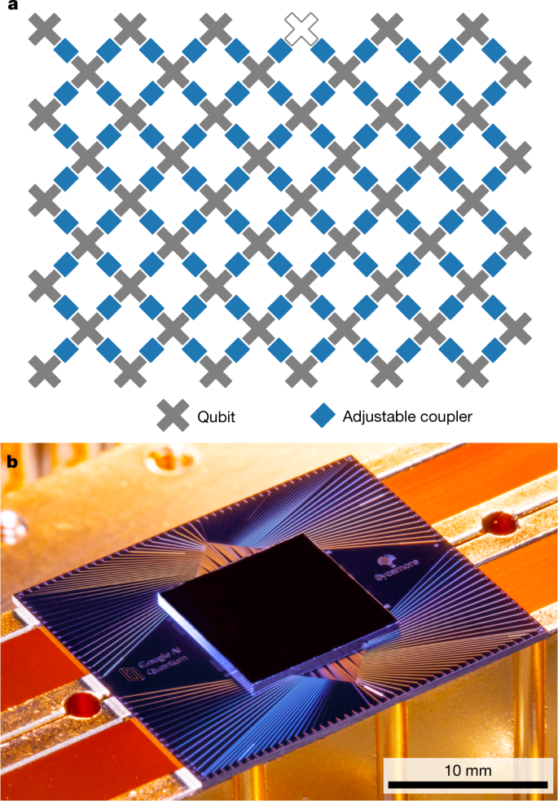
How do you do Quantum Computing?
With lots of money and lots of ice:
[20] at 20 mK = -459.634 degrees F
Or with a simulator!

Slide 14
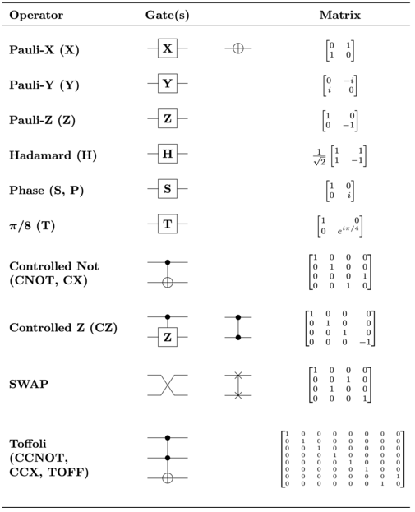
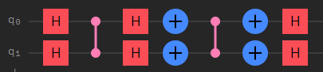
How do you do Quantum Computing? (cont.)
Quantum Gates: Operate directly on Qubits

Slide 15
What can Quantum Computing do?
Superpolynomial speedups for:
Factoring and Discrete Log [21]
Pell’s Equation [22]
Abelian Hidden Subgroup [23]
Group Order, Membership and Isopmorphism [24], [25]
Etc.
Polynomial Speedups for:
Searching [26]
Machine Learning [27]
Gradient Calculation [28]
Subset finding [29]
Etc.

Slide 16
What is Quantum Machine Learning?
Quantum Computing + Machine Learning = QML
Using a parametrized quantum computer to learn a function approximator

Slide 17
How do you do QML?
Usually with a simulator (for now)
Pennylane [30] is in my ears and in my eyes There beneath the blue suburban skies
Let me take you down 'Cause I'm going to Strawberry Fields [31] Nothing is real
TensorFlow-Quantum [32]
Qiskit [47]

Slide 18
How do you do QML? (cont.)
Quantum Hopfield Neural Networks [33]
Quantum Support Vector Machine (SVM) [34]
Quantum Perceptron [35]
Quantum Approximate Optimization Algorithm (QAOA) [36]
Quantum Neural Network/Quantum Variational Circuit (QVC)

Slide 19
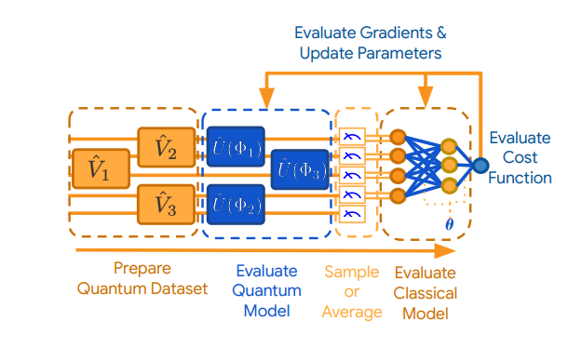
QVC (cont.)
Similar paradigm to deep learning b with mathematical differences
3 parts to a QVC: encoder, parametrized circuit, readout operators
Can be updated via gradient descent

Slide 20
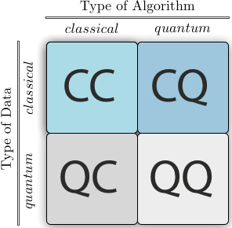
What can you do with QML?
QQ may be area with greatest potential speedup
CQ requires conversion of classical data to quantum data

Slide 21
What can you do with QML?
Variational Quantum Eigensolver (VQE) [37]
Variational Quantum Linear Solver (VQLS) [38]
Variational Quantum Thermalizer (VQT) [39]
Drug Discovery with QML [41]
Quantum Generative Adverserial Networks (GANs) [42]

Slide 22
Problems with QML
Barren Plateaus [40]
Converting classical data to quantum data requires > 2^N gates (eliminating the quantum advantage?)
Hardware is hard (or so I’m told)
Lots of noise and not a lot of qubits

Slide 23
Quantum Reinforcement Learning
Reinforcement learning = sample inefficient
QML = representational power, fewer parameters
QML + RL = match made in heaven?
Differing techniques:
Grover iteration [43]
CV Photonic gates [44]
QVC for function approximation in DQN [45]

Slide 24
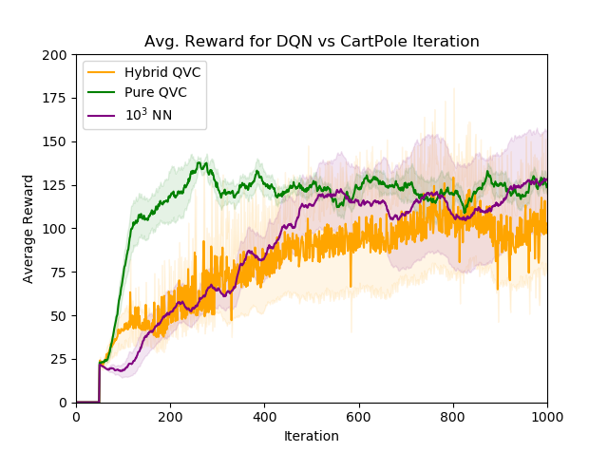
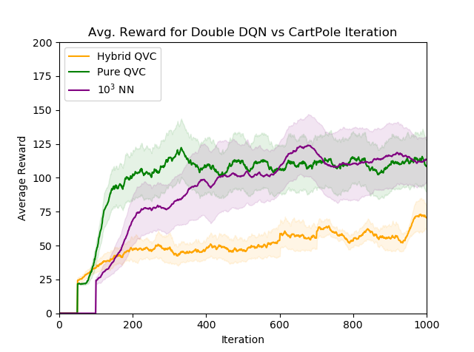
Our work [46]
Using QVC for function approximation in existing RL algorithms
Encode classical information via suboptimal (but fast) encoding

Slide 25
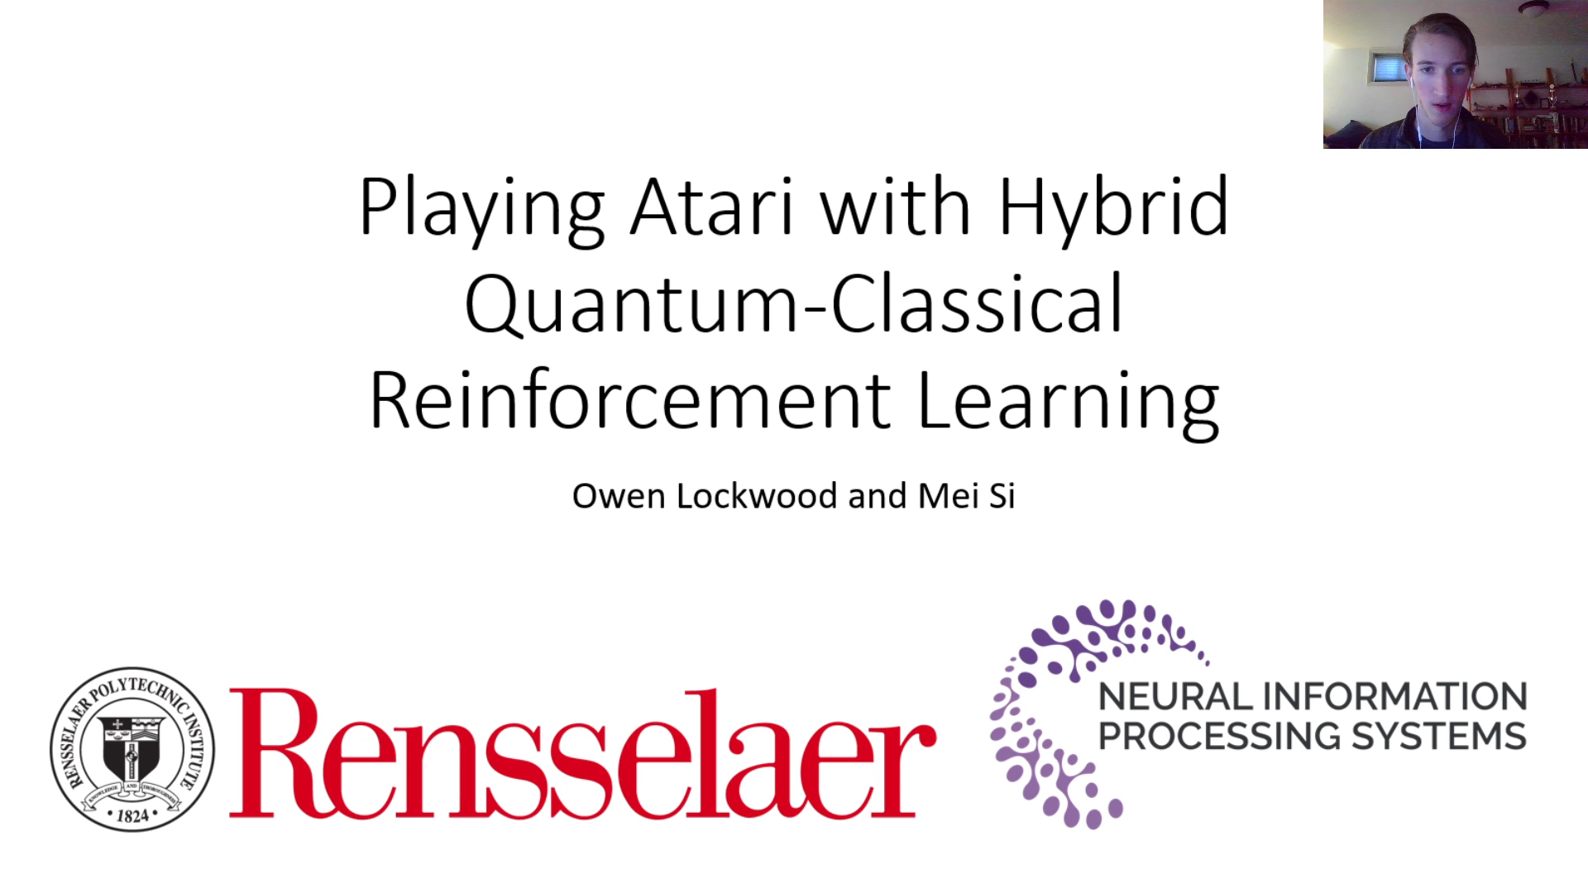
Our work (cont.)

Slide 26
What can you do?
Lots of open problems in RL, QML and the merging of the two fields
Take classes:
ML from data
Intro to AI
Quantum Mechanics
Quantum Computing (supposedly Malik is teaching that next Fall)
Game AI
Etc.
Get involved with research! Now is a great time!
Contact me: lockwo@rpi.edu

Slide 27
Questions?

Slide 28
Citations
[1] Sutton, R. S., & Barto, A. G. (2018). Reinforcement learning: An introduction. MIT press.
[2] Mnih, V., Kavukcuoglu, K., Silver, D., Rusu, A. A., Veness, J., Bellemare, M. G., ... & Petersen, S. (2015). Human-level control through deep reinforcement learning. nature, 518(7540), 529-533.
[3] Badia, A. P., Piot, B., Kapturowski, S., Sprechmann, P., Vitvitskyi, A., Guo, D., & Blundell, C. (2020). Agent57: Outperforming the atari human benchmark. arXiv preprint arXiv:2003.13350.
[4] Silver, D., Huang, A., Maddison, C. J., Guez, A., Sifre, L., Van Den Driessche, G., ... & Dieleman, S. (2016). Mastering the game of Go with deep neural networks and tree search. nature, 529(7587), 484-489.
[5] Silver, D., Hubert, T., Schrittwieser, J., Antonoglou, I., Lai, M., Guez, A., ... & Lillicrap, T. (2018). A general reinforcement learning algorithm that masters chess, shogi, and Go through self-play. Science, 362(6419), 1140-1144.

Slide 29
Citations (cont.)
[6] Vinyals, O., Babuschkin, I., Chung, J., Mathieu, M., Jaderberg, M., Czarnecki, W. M., ... & Ewalds, T. (2019). Alphastar: Mastering the real-time strategy game starcraft ii. DeepMind blog, 2.
[7] Vinyals, O., Babuschkin, I., Czarnecki, W. M., Mathieu, M., Dudzik, A., Chung, J., ... & Oh, J. (2019). Grandmaster level in StarCraft II using multi-agent reinforcement learning. Nature, 575(7782), 350-354.
[8] Berner, C., Brockman, G., Chan, B., Cheung, V., Dębiak, P., Dennison, C., ... & Józefowicz, R. (2019). Dota 2 with large scale deep reinforcement learning. arXiv preprint arXiv:1912.06680.
[9] Akkaya, I., Andrychowicz, M., Chociej, M., Litwin, M., McGrew, B., Petron, A., ... & Schneider, J. (2019). Solving rubik's cube with a robot hand. arXiv preprint arXiv:1910.07113.
[10] Kendall, A., Hawke, J., Janz, D., Mazur, P., Reda, D., Allen, J. M., ... & Shah, A. (2019, May). Learning to drive in a day. In 2019 International Conference on Robotics and Automation (ICRA) (pp. 8248-8254). IEEE.

Slide 30
Citations (cont.)
[11] Henderson, P., Islam, R., Bachman, P., Pineau, J., Precup, D., & Meger, D. (2017). Deep reinforcement learning that matters. arXiv preprint arXiv:1709.06560.
[12] Engstrom, L., Ilyas, A., Santurkar, S., Tsipras, D., Janoos, F., Rudolph, L., & Madry, A. (2019, September). Implementation Matters in Deep RL: A Case Study on PPO and TRPO. In International Conference on Learning Representations.
[13] Houthooft, R., Chen, X., Duan, Y., Schulman, J., De Turck, F., & Abbeel, P. (2016). Vime: Variational information maximizing exploration. In Advances in Neural Information Processing Systems (pp. 1109-1117).
[14] Hao, K. (2019). Training a single AI model can emit as much carbon as five cars in their lifetimes. MIT Technology Review.
[15] Strubell, E., Ganesh, A., & McCallum, A. (2019). Energy and policy considerations for deep learning in NLP. arXiv preprint arXiv:1906.02243.

Slide 31
Citations (cont.)
[16] Dulac-Arnold, G., Mankowitz, D., & Hester, T. (2019). Challenges of real-world reinforcement learning. arXiv preprint arXiv:1904.12901.
[17] Dulac-Arnold, G., Levine, N., Mankowitz, D. J., Li, J., Paduraru, C., Gowal, S., & Hester, T. (2020). An empirical investigation of the challenges of real-world reinforcement learning. arXiv preprint arXiv:2003.11881.
[18] https://www.researchgate.net/publication/334442317_Playing_Pong_Game_on_a_Quantum_Computer/figures?lo=1&utm_source=google&utm_medium=organic
[19] Einstein, A., Podolsky, B., & Rosen, N. (1935). Can quantum-mechanical description of physical reality be considered complete?. Physical review, 47(10), 777.
[20] Arute, F., Arya, K., Babbush, R., Bacon, D., Bardin, J. C., Barends, R., ... & Burkett, B. (2019). Quantum supremacy using a programmable superconducting processor. Nature, 574(7779), 505-510.

Slide 32
Citations (cont.)
[21] Shor, P. W. (1999). Polynomial-time algorithms for prime factorization and discrete logarithms on a quantum computer. SIAM review, 41(2), 303-332.
[22] Freedman, M. H., Larsen, M., & Wang, Z. (2002). A modular functor which is universal for quantum computation. Communications in Mathematical Physics, 227(3), 605-622.
[23] Boneh, D., & Lipton, R. J. (1995, August). Quantum cryptanalysis of hidden linear functions. In Annual International Cryptology Conference (pp. 424-437). Springer, Berlin, Heidelberg.
[24] Watrous, J. (2001, July). Quantum algorithms for solvable groups. In Proceedings of the thirty-third annual ACM symposium on Theory of computing (pp. 60-67).
[25] Gall, F. L. (2010). An efficient quantum algorithm for some instances of the group isomorphism problem. arXiv preprint arXiv:1001.0608.

Slide 33
Citations (cont.)
[26] Grover, L. K. (1997). Quantum mechanics helps in searching for a needle in a haystack. Physical review letters, 79(2), 325.
[27] Biamonte, J., Wittek, P., Pancotti, N., Rebentrost, P., Wiebe, N., & Lloyd, S. (2017). Quantum machine learning. Nature, 549(7671), 195-202.
[28] Jordan, S. P. (2005). Fast quantum algorithm for numerical gradient estimation. Physical review letters, 95(5), 050501.
[29] Childs, A. M., & Eisenberg, J. M. (2003). Quantum algorithms for subset finding. arXiv preprint quant-ph/0311038.
[30] Bergholm, V., Izaac, J., Schuld, M., Gogolin, C., Alam, M. S., Ahmed, S., ... & McKiernan, K. (2018). Pennylane: Automatic differentiation of hybrid quantum-classical computations. arXiv preprint arXiv:1811.04968.

Slide 34
Citations (cont.)
[31] Killoran, N., Izaac, J., Quesada, N., Bergholm, V., Amy, M., & Weedbrook, C. (2019). Strawberry fields: A software platform for photonic quantum computing. Quantum, 3, 129.
[32] Broughton, M., Verdon, G., McCourt, T., Martinez, A. J., Yoo, J. H., Isakov, S. V., ... & Leib, M. (2020). Tensorflow quantum: A software framework for quantum machine learning. arXiv preprint arXiv:2003.02989.
[33] Rebentrost, P., Bromley, T. R., Weedbrook, C., & Lloyd, S. (2018). Quantum Hopfield neural network. Physical Review A, 98(4), 042308.
[34] Rebentrost, P., Mohseni, M., & Lloyd, S. (2014). Quantum support vector machine for big data classification. Physical review letters, 113(13), 130503.
[35] Kapoor, A., Wiebe, N., & Svore, K. (2016). Quantum perceptron models. In Advances in Neural Information Processing Systems (pp. 3999-4007).

Slide 35
Citations (cont.)
[36] Farhi, E., Goldstone, J., & Gutmann, S. (2014). A quantum approximate optimization algorithm. arXiv preprint arXiv:1411.4028.
[37] Peruzzo, A., McClean, J., Shadbolt, P., Yung, M. H., Zhou, X. Q., Love, P. J., ... & O’brien, J. L. (2014). A variational eigenvalue solver on a photonic quantum processor. Nature communications, 5, 4213.
[38] Bravo-Prieto, C., LaRose, R., Cerezo, M., Subasi, Y., Cincio, L., & Coles, P. (2020). Variational quantum linear solver: A hybrid algorithm for linear systems. Bulletin of the American Physical Society, 65.
[39] Verdon, G., Marks, J., Nanda, S., Leichenauer, S., & Hidary, J. (2019). Quantum hamiltonian-based models and the variational quantum thermalizer algorithm. arXiv preprint arXiv:1910.02071.
[40] McClean, J. R., Boixo, S., Smelyanskiy, V. N., Babbush, R., & Neven, H. (2018). Barren plateaus in quantum neural network training landscapes. Nature communications, 9(1), 1-6.

Slide 36
Citations (cont.)
[41] Batra, K., Zorn, K. M., Foil, D. H., Minerali, E., Gawriljuk, V. O., Lane, T. R., & Ekins, S. (2020). Quantum Machine Learning for Drug Discovery.
[42] Dallaire-Demers, P. L., & Killoran, N. (2018). Quantum generative adversarial networks. Physical Review A, 98(1), 012324.
[43] Ganger, M., & Hu, W. (2019). Quantum Multiple Q-Learning. International Journal of Intelligence Science, 9(01), 1.
[44] Hu, W., & Hu, J. (2019). Reinforcement Learning with Deep Quantum Neural Networks. Journal of Quantum Information Science, 9(1), 1-14.
[45] Chen, S. Y. C., Yang, C. H. H., Qi, J., Chen, P. Y., Ma, X., & Goan, H. S. (2020). Variational quantum circuits for deep reinforcement learning. IEEE Access, 8, 141007-141024.

Slide 37
Citations (cont.)
[46] Lockwood, O., & Si, M. (2020, October). Reinforcement Learning with Quantum Variational Circuit. In Proceedings of the AAAI Conference on Artificial Intelligence and Interactive Digital Entertainment (Vol. 16, No. 1, pp. 245-251).
[47] Aleksandrowicz, G., Alexander, T., Barkoutsos, P., Bello, L., Ben-Haim, Y., Bucher, D., ... & Chow, J. M. (2019). Qiskit: An open-source framework for quantum computing. Accessed on: Mar, 16.

